Slide 1
Suzhou Talent Microwave,Inc sales@talentmw.com www.talentmw.com
Solid State High Power Amplifier Systems
40-50GHz/50dB Gain/50dBm Psat/220V AC Model: TLPA40G50G-50-50-BC
TLPA40G50G-50-50-BC is a solid state high power amplifier systems provides high output power and high gain across the 40 to 50 GHz frequency range. The amplifier features a built-in 220V power supply, making it easy to use in most lab environments. This model features thermal self protection, preventing damage to the amplifier and providing added reliability.
Features:
Frequency range: 40-50GHz
Gain: 50dB Min
Psat Output Power: 50dBm Min
Protection:Over TEM,over voltage, over current ,over VSWR protection
50 Ohm Matched Input / Output
Electrical Characteristics:
Parameter | Symbol | Min | Typ | Max | Units
Frequency range | BW | 40 |  | 50 | GHz
Power Gain@Pout=50dBm | GP | 50 |  |  | dB
Gain flatness | ΔGL |  | ±5 |  | dB
Output Psat | Psat | 50 |  |  | dBm
Spurious@Pout=50dBm | Spur |  |  | -60 | dBc
Harmonics | HAM |  |  | -20 | dBc
Input VSWR | VSWRin |  | 2.5 | 3 | :1
AC Voltage | Vac |  | 220 |  | V AC
Power Consumption | Pdiss |  |  | 2000 | W
Impedance | I/O-IMP | 50 |  |  | Ohms
Mechanical Specifications:
Parameter | Value | Units
Input /Output Connector | 2.4mm Female/WR22
Forward/Reverse Coupling | 2.4mm Female/2.4mm Female
Communication Connector | DB9/RJ45
Size | 19 Inch 4U*550 | mm
Weight | ≤35 | Kg

Slide 2
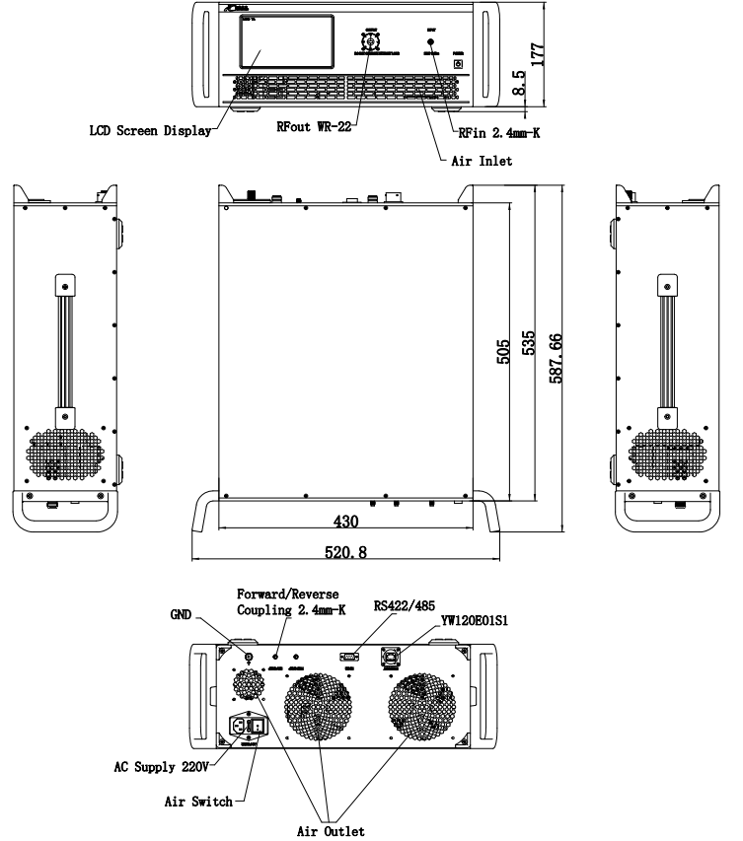
Suzhou Talent Microwave,Inc sales@talentmw.com www.talentmw.com
Absolute Maximum Ratings:
Parameter | Value
RF Input Power | +5 dBm
ESD sensitivity (HBm) | Class 0, passed 150V
Outline Drawing:
Unit:mm; Tolerance:±0.1mm

Slide 3

Suzhou Talent Microwave,Inc sales@talentmw.com www.talentmw.com
Key Features:
Parameter | Advantages
Control functions | 1, Power setting on/off 2, ALC automatic level control
Protection functions | 1, Over TEM 2, Over voltage 3, Over current 4, Over VSWR
Display functions | 1, Output/reflected power 2, Fault informations
Remote control | RS422/Ethernet
Cooling system | Built in Cooling system,forced air cooling
Environmental Conditions:
Parameter | Min | Typ | Max | Units
Operating Temperature* | -20 |  | +40 | ℃
Non-operating Temperature* | -30 |  | +50 | ℃
Relative humidity |  | 95 |  | %
Altitude | 10,000 |  |  | feet
Shock / Vibration(MIL-STD-810F) | 25g rms (15 degree 2KHz) endurance, 1 hour per axis
Shock(non operating) | 20G for 11msc half sin wave,3 axis both directions
*Note: For a wider temperature range, please consult the manufacturer.
Ordering Information:
Base Number | Description | Revision
TLPA40G50G-50-50-BC | Solid State High Power Amplifier Systems 40-50GHz,Gain:50dB,Psat:50dBm,220V AC,Built in Fan Cooling | Rev.1.0

