Slide 1
Suzhou Talent Microwave,Inc sales@talentmw.com www.talentmw.com
Solid State High Power Amplifier Systems
40-50GHz/50dB Gain/50dBm Psat/220V AC Model: TLPA40G50G-50-50-BC
TLPA40G50G-50-50-BC is a solid state high power amplifier systems provides high output power and high gain across the 40 to 50 GHz frequency range. The amplifier features a built-in 220V power supply, making it easy to use in most lab environments. This model features thermal self protection, preventing damage to the amplifier and providing added reliability.
Features:
Frequency range: 40-50GHz
Gain: 50dB Min
Psat Output Power: 50dBm Min
Protection:Over TEM,over voltage, over current ,over VSWR protection
50 Ohm Matched Input / Output
电气特性 Electrical Characteristics:
参数 Parameter | 代码 Symbol | Min | Typ | Max | 单位 Units
频率范围 Frequency range | BW | 40 |  | 50 | GHz
功率增益 Power Gain@Pout=50dBm | GP | 50 |  |  | dB
增益平坦度 Gain flatness | ΔGL |  | ±5 |  | dB
饱和输出功率 Output Psat | Psat | 50 |  |  | dBm
杂散 Spurious@Pout=50dBm | Spur |  |  | -60 | dBc
谐波 Harmonics | HAM |  |  | -20 | dBc
输入驻波 Input VSWR | VSWRin |  | 2.5 | 3 | :1
交流电压 AC Voltage | Vac |  | 220 |  | V AC
功耗 Power Consumption | Pdiss |  |  | 2000 | W
阻抗 Impedance | I/O-IMP | 50 |  |  | Ohms
机械特性 Mechanical Specifications:
参数 Parameter | 指标 Value | 单位 Units
输入/输出接口 Input /Output Connector | 2.4mm Female/WR22
正向/反向耦合 Forward/Reverse Coupling | 2.4mm Female/2.4mm Female
通信接口 Communication Connector | DB9/RJ45
尺寸 Size | 19 Inch 4U*550 | mm
重量 Weight | ≤35 | Kg

Slide 2
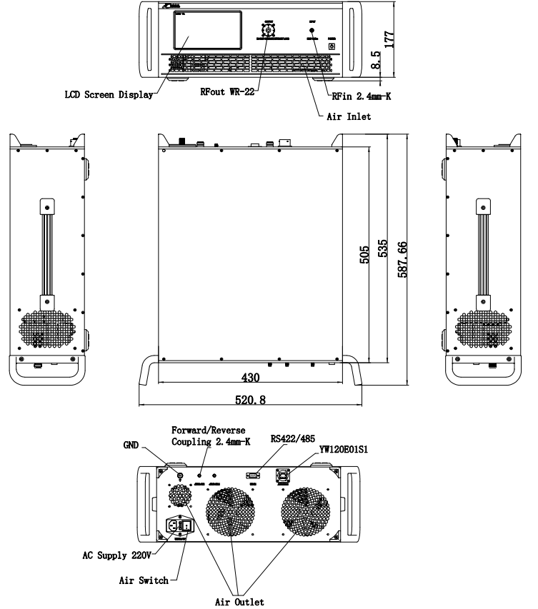
Suzhou Talent Microwave,Inc sales@talentmw.com www.talentmw.com
绝对最大值 Absolute Maximum Ratings:
参数 Parameter | 指标 Value
输入功率 RF Input Power | +5 dBm
ESD灵敏度 ESD sensitivity (HBm) | Class 0, passed 150V
外形图 Outline Drawing:
Unit:mm; Tolerance:±0.1mm

Slide 3

Suzhou Talent Microwave,Inc sales@talentmw.com www.talentmw.com
主要功能 Key Features:
参数 Parameter | 特点 Advantages
控制功能 Control functions | 1, Power setting on/off 2, ALC automatic level control
内置保护功能 Protection functions | 1, Over TEM 2, Over voltage 3, Over current 4, Over VSWR
显示功能 Display functions | 1, Output/reflected power 2, Fault informations
监控和控制 Remote control | RS422/Ethernet
冷却系统 Cooling system | Built in Cooling system,forced air cooling
温度环境 Environmental Conditions:
参数 Parameter | Min | Typ | Max | 单位 Units
操作温度 Operating Temperature* | -20 |  | +40 | ℃
存储温度 Non-operating Temperature* | -30 |  | +50 | ℃
相对湿度 Relative humidity |  | 95 |  | %
海拔 Altitude | 10,000 |  |  | feet
震动 Shock / Vibration(MIL-STD-810F) | 25g rms (15 degree 2KHz) endurance, 1 hour per axis
冲击 Shock(non operating) | 20G for 11msc half sin wave,3 axis both directions
*Note: For a wider temperature range, please consult the manufacturer.
订货信息 Ordering Information:
标准型号 Base Number | 描述 Description | 版本号 Revision
TLPA40G50G-50-50-BC | Solid State High Power Amplifier Systems 40-50GHz,Gain:50dB,Psat:50dBm,220V AC,Built in Fan Cooling | Rev.1.0

